Slide 1

Age & Gender Detection
Presented By - Kartik Khare
Presented To - Mr. Manish Gupta (Assistant Professor)

Slide 2
Contents
Abstract
Introduction
Methodology
Result
Conclusion

Slide 3
Abstract
In recent years, one of the most frequently discussed issues in the field of pattern recognition and computer vision has been age estimation and gender classification. This project proposes automated age and gender-based feature extraction from human facial images.
In contrast to other conventional approaches on unfiltered face images, we show in this study that learning representations with deep convolutional neural networks (CNN) generates a significant improvement for these tasks. The feedforward neural network method used in this study improves robustness for highly variable unconstrained recognition tasks such as gender and age group estimation.

Slide 4
It is difficult to predict the exact age of a person using one frame due to the facial expressions, lighting, makeup and many other real-world imaging conditions, for this purpose various age ranges are taken, and the predicted age falls In one of them.
On the Adience benchmark, this research was analyzed and validated for gender prediction and age estimation. This dataset includes various real-world imaging conditions.
The results show that the proposed approach provides a significant performance boost, with our model achieving very interesting efficiency and state-of-the-art performance in both age and gender scoring.

Slide 5
Introduction
The rate of image uploads to the Internet has increased at a nearly exponential rate over the last decade. This newly discovered wealth of data has enabled computer scientists to tackle previously irrelevant or intractable computer vision problems. As a result, we've seen the emergence of highly accurate and efficient facial detection frameworks powered by convolutional neural networks.
Applications for these systems range from recommending who to "tag" in Facebook photos and to detecting pedestrians in self-driving cars.
For example, if a photo shows a group of people studying together, Facebook may be able to caption the scene "study session." However, if it can also detect that the people are all men in their early twenties wearing shirts with the same letters, it may predict "College students in a fraternity studying."

Slide 6
Age and gender classification is an inherently difficult problem, more so than many other computer vision tasks. The main reason for this disparity in complexity is the nature of the data required to train these types of systems.
While general object classification tasks can often have access to hundreds of thousands, if not millions, of images for training, datasets with age and/or gender labels are much smaller, usually in the thousands or, at most, tens of thousands The reason for this is that in order to have labels for such images, we need access to the personal information of the subjects in the images.

Slide 7
We would need their date of birth and gender, and the date of birth in particular is a rarely released piece of information. As a result, we must accept the nature of the problem at hand and tailor network architectures and algorithmic approaches to account for these constraints. These are the primary reasons why chose to implement a relatively shallow architecture for age and gender classification using convolutional neural networks, and we have followed sequences.

Slide 8

Methodology
Description of the dataset
Research Methodology

Slide 9
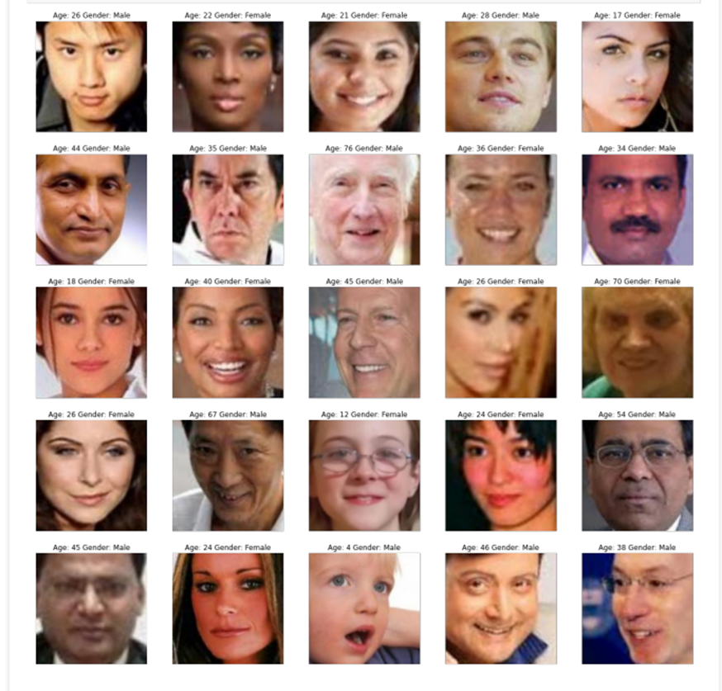
Description of the dataset
The Adience face dataset from the Open University of Israel's Face Image Project was used for training and testing in this project. This dataset contains a total of 26,580 photos from Flickr of 2,284 different subjects. Each image includes the person's gender and age range (out of 6 possible ranges). The images have different levels of occlusion, lighting, and blur to reflect real-world conditions.
We used mostly front-facing images, which kept the total number of images to around 20,000. The images were originally 768x768, so they were all resized to 256x256 before being preprocessed.

Slide 10
Research Methodology
Convolutional neural networks are one of the most common types of neural networks used for image recognition and classification.
CNNs are composed of alternating S-layers and C-layers, known as convolution and sub-sampling, with one or more fully connected layers (FC) at the ends. Convolutional Neural Networks are a type of multi-layer neural network that, in shape, structure, and learning philosophy, follow the path of its predecessor recognition. Traditionally, neural networks convert input data into a one-dimensional vector and can perform feature extraction as well as classification. The input layer is fed images that have been normalized and are all the same size.
To classify an object with probabilistic values, each input image will be passed through a series of convolution layers with filters (Kernels), Pooling, fully connected layers (FC) and an activation function.
Notes:
Pooling is nothing other than down sampling of an image.
Fully-connected layers, also known as linear layers, connect every input neuron to every output neuron and are commonly used in neural networks.
The activation function compares the input value to a threshold value. If the input value is greater than the threshold value, the neuron is activated. It's disabled if the input value is less than the threshold value, which means its output isn't sent on to the next or hidden layer.

Slide 11
Our proposed network architecture is used throughout our experiments for age and gender classification. The network is made up of only three convolutional layers and two fully connected layers with a small number of neurons. This is in comparison to the much larger architectures used. We chose a smaller network design to reduce the risk of overfitting as well as the nature of the problems we are attempting to solve: age classification on the Adience set requires distinguishing between six age classes; gender only two.
The network directly processes all three color channels. Images are first rescaled to 256 x 256 before being fed to the network with a crop of 227 x 227. Following that, the three subsequent convolutional layers are defined as follows:

Slide 12
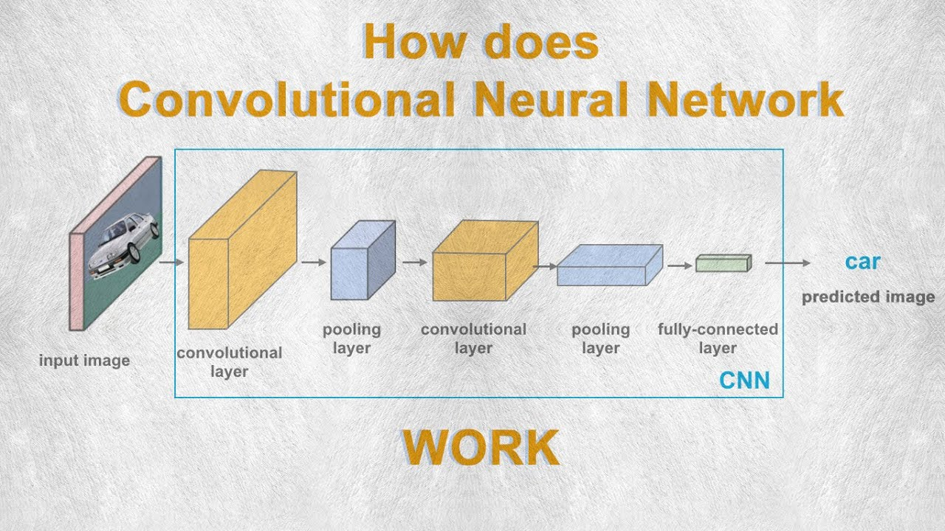

Slide 13
1. In the first convolutional layer, 96 filters of 3747 pixels are applied to the input, followed by a rectified linear operator (ReLU), a max pooling layer with the maximum value of 3x3 regions with two pixel strides, and a local response normalization layer.
2. The previous layer's 96 x 28 x 28 output is then processed by the second convolutional layer, which contains 256 filters of size 96 x 5 x 5 pixels. Following this, ReLU, a max pooling layer, and a local response normalization layer with the same hyper parameters as before are applied.
3. Finally, the third and final convolutional layer applies a set of 384 filters of size 256 x 3 x 3 pixels to the 256 x 14 x 14 blob, followed by ReLU and a max pooling layer.

Slide 14
4. The fully connected layers that follow are then defined as:
A first fully connected layer with 512 neurons that receives the output of the third convolutional layer, followed by a ReLU and a dropout layer.
A second fully connected layer that receives the first fully connected layer's 512- dimensional output and contains 512 neurons again, followed by a ReLU and a dropout layer.
A third, fully connected layer that maps to the final age or gender classes.
5. Finally, the last fully connected layer's output is fed into a softmax layer, which assigns a probability to each class. The prediction is made by selecting the class with the gre

Slide 15
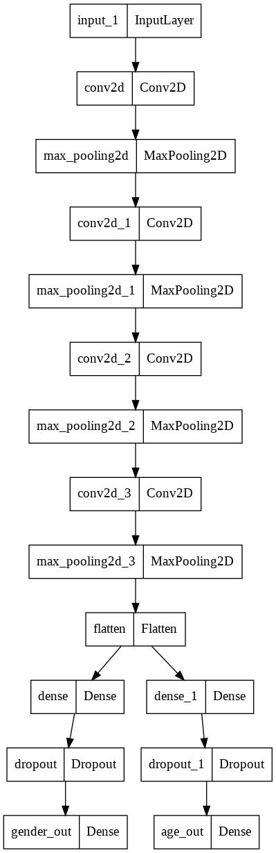

Slide 16
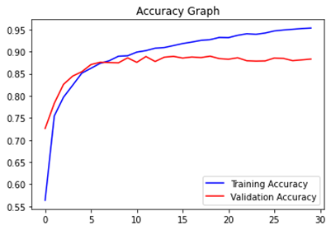
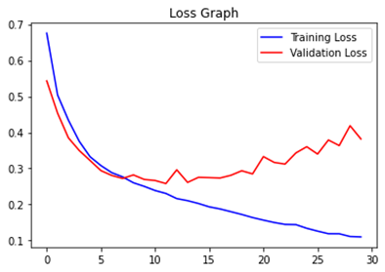
Result
We tackled the classification of age group and gender of face images as a multiclass classification problem, training the model with a classification-based loss function as training targets. We preprocess the training dataset image by flattening a one-dimensional vector feature of the input image for age and gender.
The result of the last layer CNN Based Features Extraction for Age Estimation and of convolutional network is passed to three fully connected layers, finally outputs are given to the fully connected layers to minimize the classification loss by the softmax function on six age classes (groups 0-6, 8-20, 25-32, 38-43, 48-53, and + 60 years old).

Slide 17
Conclusion
Using data from the Internet, we examine how well deep CNN perform on various tasks using an example from the related topic of facial recognition. We draw conclusions using a minimalist deep learning architecture intended to prevent overfitting as a result of the scarcity of labelled data.
Our network has fewer parameters and a lower likelihood of overfitting because it is "shallow" in comparison to certain current network topologies. By intentionally incorporating cropped versions of the photographs from our training set, we increase the amount of the training data even more
Our observations lead to two important conclusions: First, even with the much smaller size of contemporary unconstrained image sets labelled for age and gender, CNN can be used to provide improved age and gender classification results. Second, the simplicity of our model implies that more complex systems with more training data may be capable of significantly improving on the results reported here.
Notes:
Pooling is nothing other than down sampling of an image.
Fully-connected layers, also known as linear layers, connect every input neuron to every output neuron and are commonly used in neural networks.
The activation function compares the input value to a threshold value. If the input value is greater than the threshold value, the neuron is activated. It's disabled if the input value is less than the threshold value, which means its output isn't sent on to the next or hidden layer.

Slide 18


